Slide 1
Analyzing Amazon Sales Data
Project Report
Archana Malviya

Slide 2
Project Details-
Project title- Analysing Amazon Sales data
Technologies- Data Science
Domain- E-commerce
Project Difficulties level Advanced
Tools Used – Power BI & Advanced Excel

Slide 3
Objective-
Goal
find Sales-trend -> month-wise, year-wise, yearly_month-wise.
Find key metrics and factors and show the meaningful relationships between attributes.

Slide 4
DataSet Information-
* Region - Gives the different regions of the sales all over the world.
* Country - The country of the sale item.
* Item type - About different item types.
* Sales Channel - There are two sales channel modes - Online and Offline
* Order Priority - Four Letters C H L M used to represent order priority.
* Order Date - The date of placing the order in mixed format. (Non uniform date formats)
* Ship Date - The shipping date of the product.
* Units Sold - Number of units of the particular item sold.
* Unit Price - Unit Price of the particular item at which it is sold.
* Unit Cost - Unit Cost i.e. per unit amount spend to make the product.
* Total Revenue - Total revenue generated for the item for the given region and country.
* Total Cost - Similarly Total cost
* Total Profit - and Total Profit

Slide 5
Detailed Description:
Following insights can be helpful to improve the sales of the company:
Unit Price - Most of the unit price is within 180 dollars value as shown by the median value. The maximum unit price can be seen 668.27 and there is not any outliers as can be seen from the box plot.
Unit Cost - Most of the unit cost is within 107 dollars as is shown by the median value. From box plots we can see here again we do not have any outliers, the maximum unit cost we have is around 525 dollars.
Total Profit -
Most of the Total Profit values is within 2.9e+05 dollars as is shown by the median value.
From the box plot we can see we have more than 3 outliers for this column
Maximum total profit appears in months Feb and Nov , and least in Mar and Aug
Also, the total profit is maximum for year 2012 and least in 2011
And maximum profit is obtained from cosmetics and minimum with food items such as Fruits, beverages and meat.

Slide 6
Units Sold -
Most of the units Sold lies within 5383 units as can be seen from the median value. From box plots we can say again here we do not have any outliers, the maximum Units Sold is 9925 units and minimum we have is 124 units.
We can see highest units sold are in Jul month followed by Feb, and least in Aug, March and Dec
Maximum units were sold at year 2012 and next at year 2014
Clothes and Cosmetics have the maximum units sold, meat is minimum
Shipping Duration - Most of the values in shipping duration is within 24 days as is shown by the median value and also the deviation or spread of data is lesser. Clearly, we do not have any outliers here, the maximum and minimum values are 50 and 0 days.

Slide 7
Item Type - Most of the item types are Clothes, Cosmetics and Office Supplies
Region - The most common regions are Sub-Saharan Africa (37) and Europe (24).
Shipping day name - Most of the shipping is happening on Saturdays and Wednesdays and least on Sundays

Slide 8
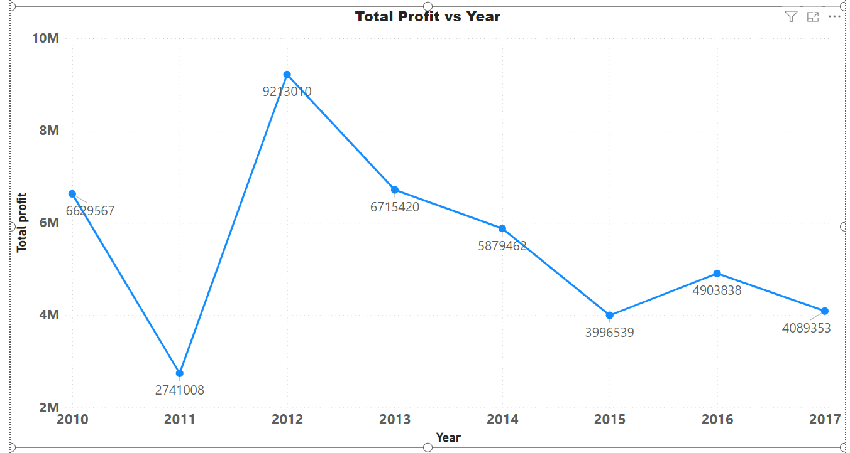
Insights-
Maximum Profit for Year is 2012.
Which is kept decreasing after 2012 till 2017.

Slide 9
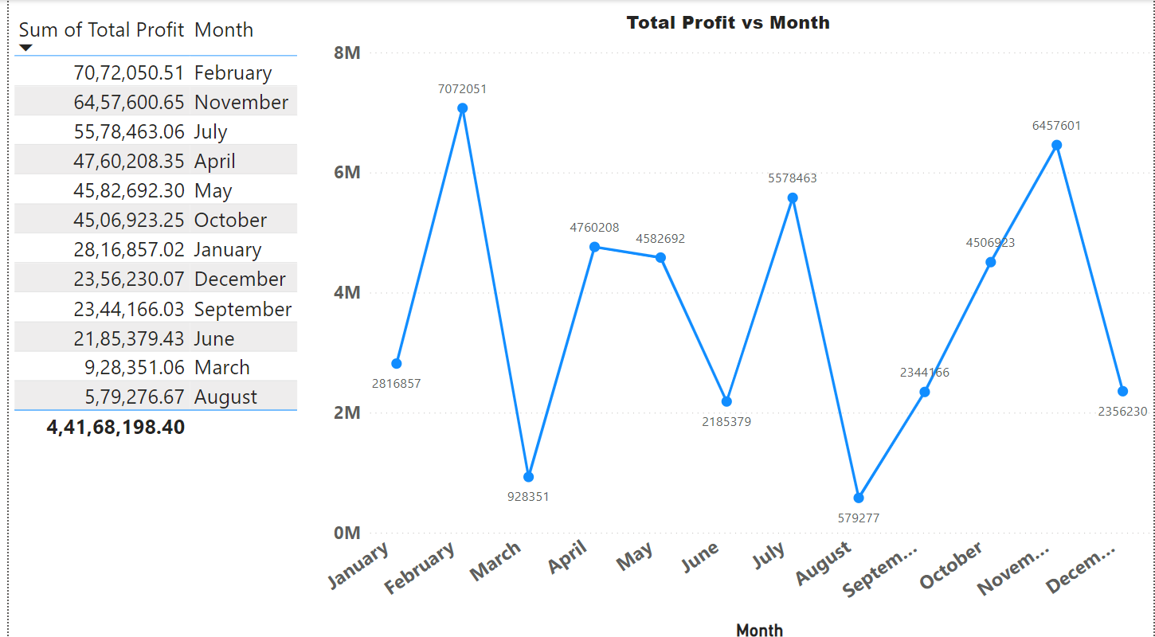
2.
Most of the Total Profit Received in Feb & Nov month.
Least in Aug & March month.

Slide 10
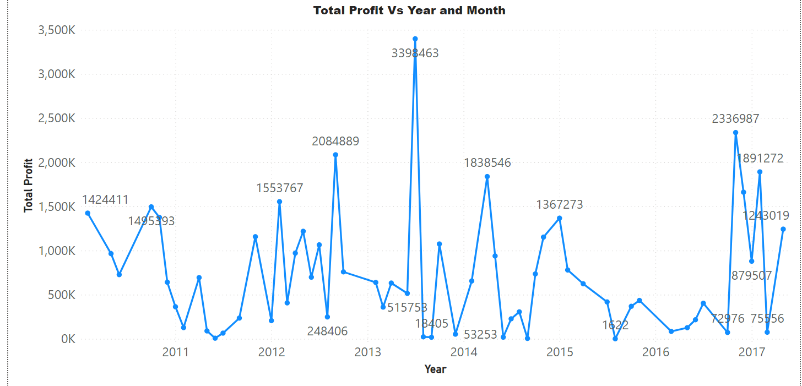
3.
We can see a
sharp peak between
the year 2013 and 2014.

Slide 11
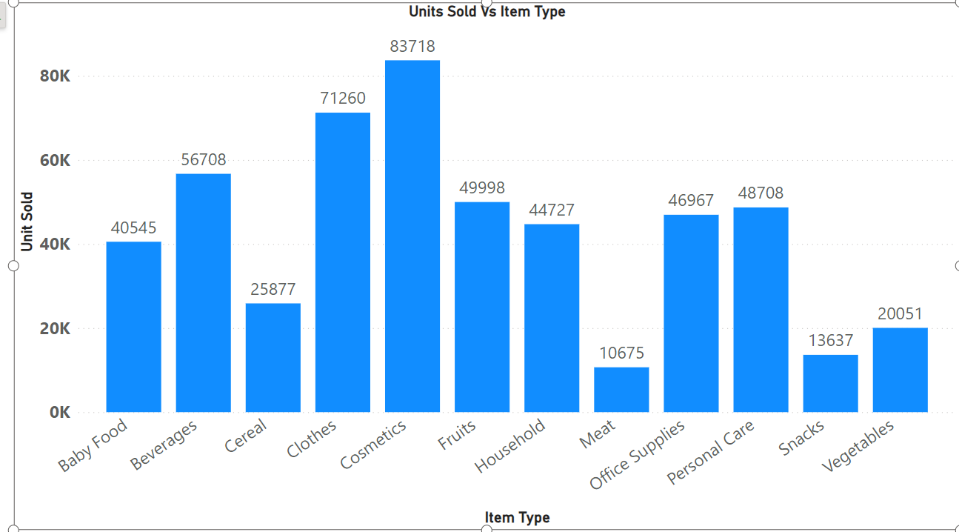
4.
We can see that the cosmetics is the most
Sold product with
Following clothes type.
And for the least unit
Sold are snacks and
Meat type.

Slide 12
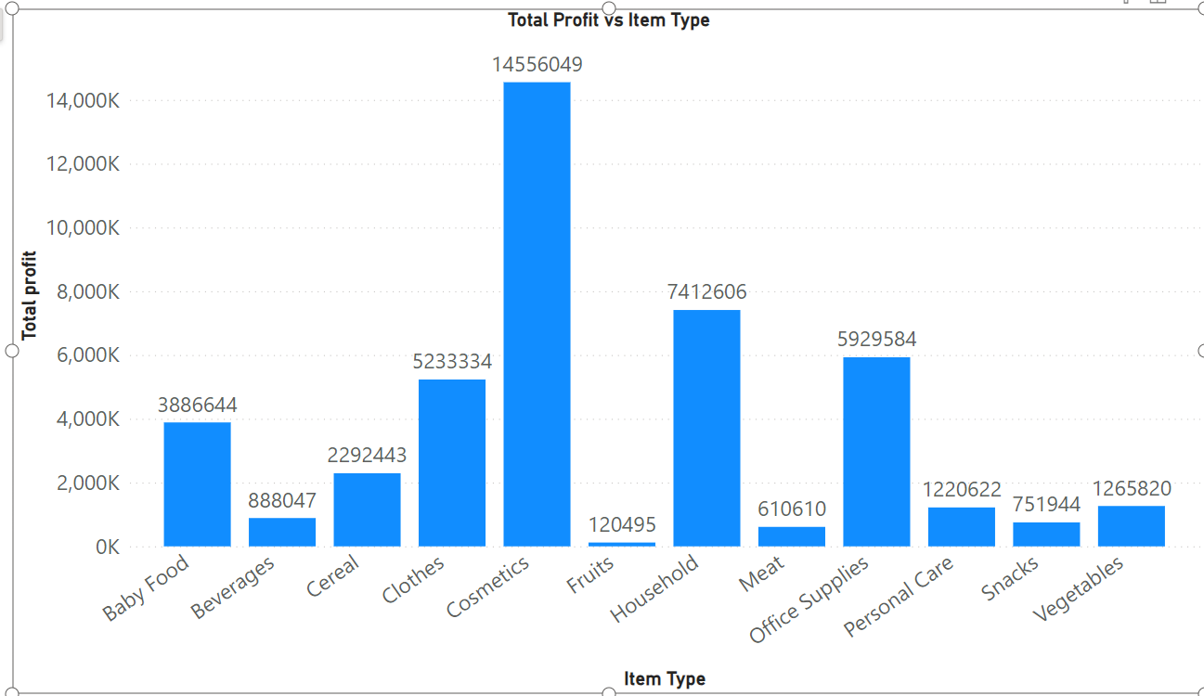
5.
The Total profit for
Cosmetic type is
Maximum.
Lowest for Fruits.

Slide 13
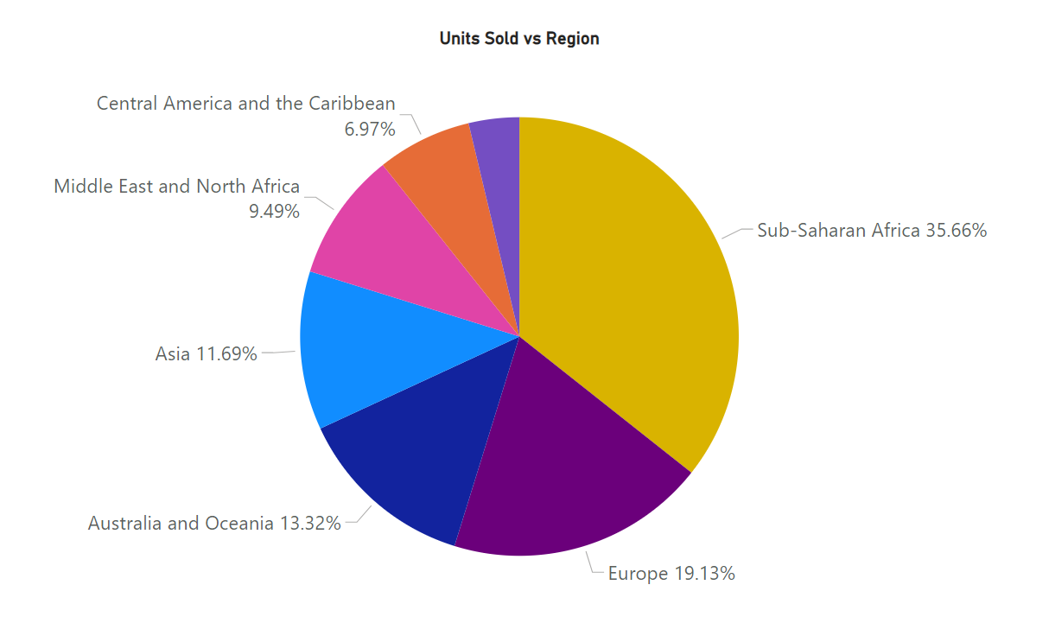
6.
Most unit sold
in Sub-Saharan Africa Region with 35.66%
Least unit sold in North America with 3.73%

Slide 14
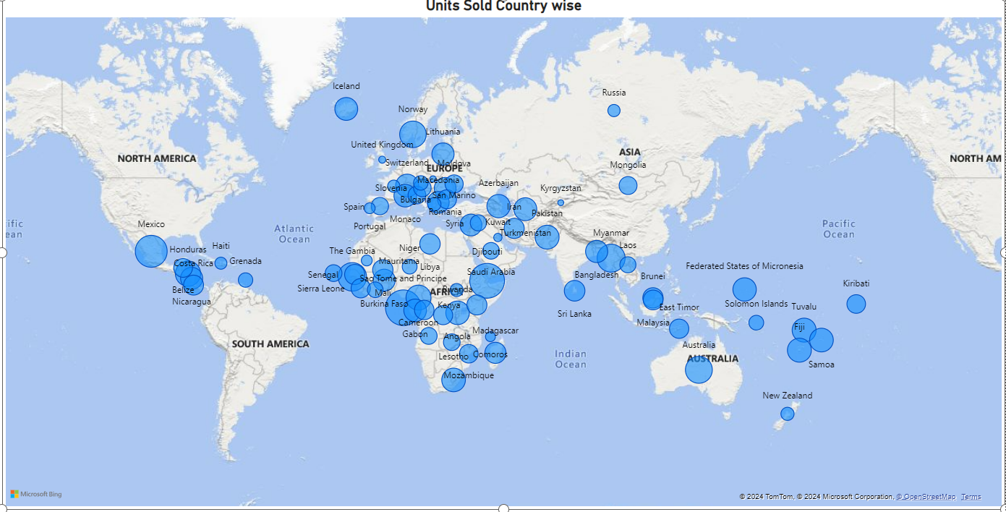
Unit sold in Different Countires

Slide 15
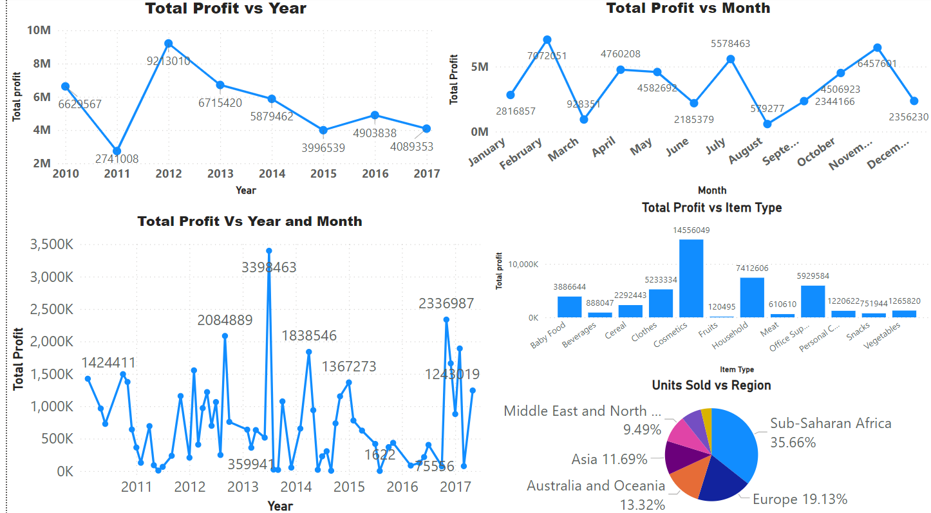
Final Report

Slide 16
KPI-
1. Unit Profit of Items
2. Units Sold by Items, regions
3. Total Profit by Year, Month, Yearly Months

Slide 17
Conclusion-
Maximum total profit appears in months Feb and Nov , and least in Mar and Aug
The total profit is maximum for year 2012 and least in 2011
Most profitable item is cosmetics and least profitable are food items such as Fruits, beverages and meat.
Most of the item types are Clothes, Cosmetics and Office Supplies
The most units are sold in regions Sub-Saharan Africa (37) and Europe (24).
Most of the shipping is happening on Saturdays and Wednesdays and least on Sundays

